Slide 1






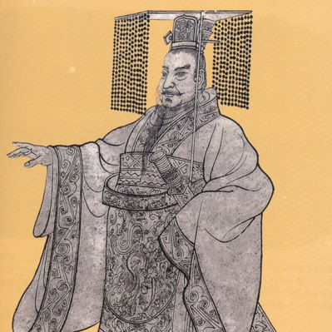

The Specialty of Sculpture Art in Qin Dynasty

Slide 2
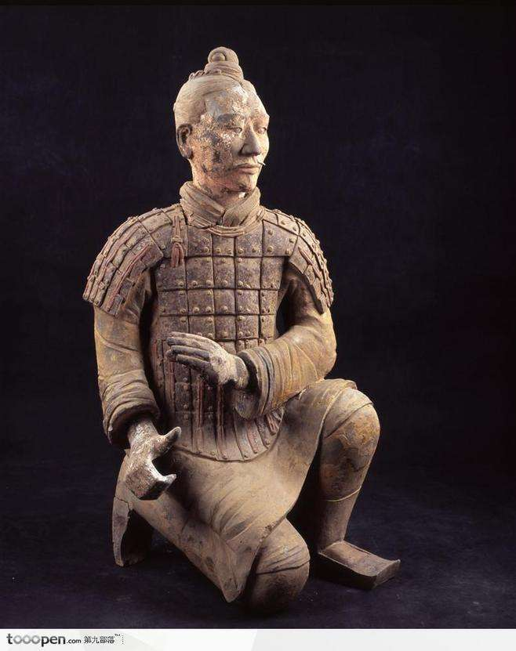
The Specialty of Sculpture Art in Qin Dynasty
The First Emperor of Qin
Terra-Cotta Warriors

Slide 3
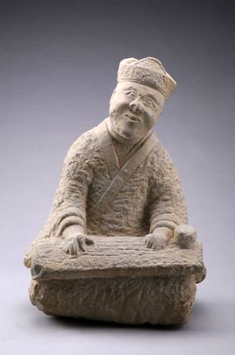
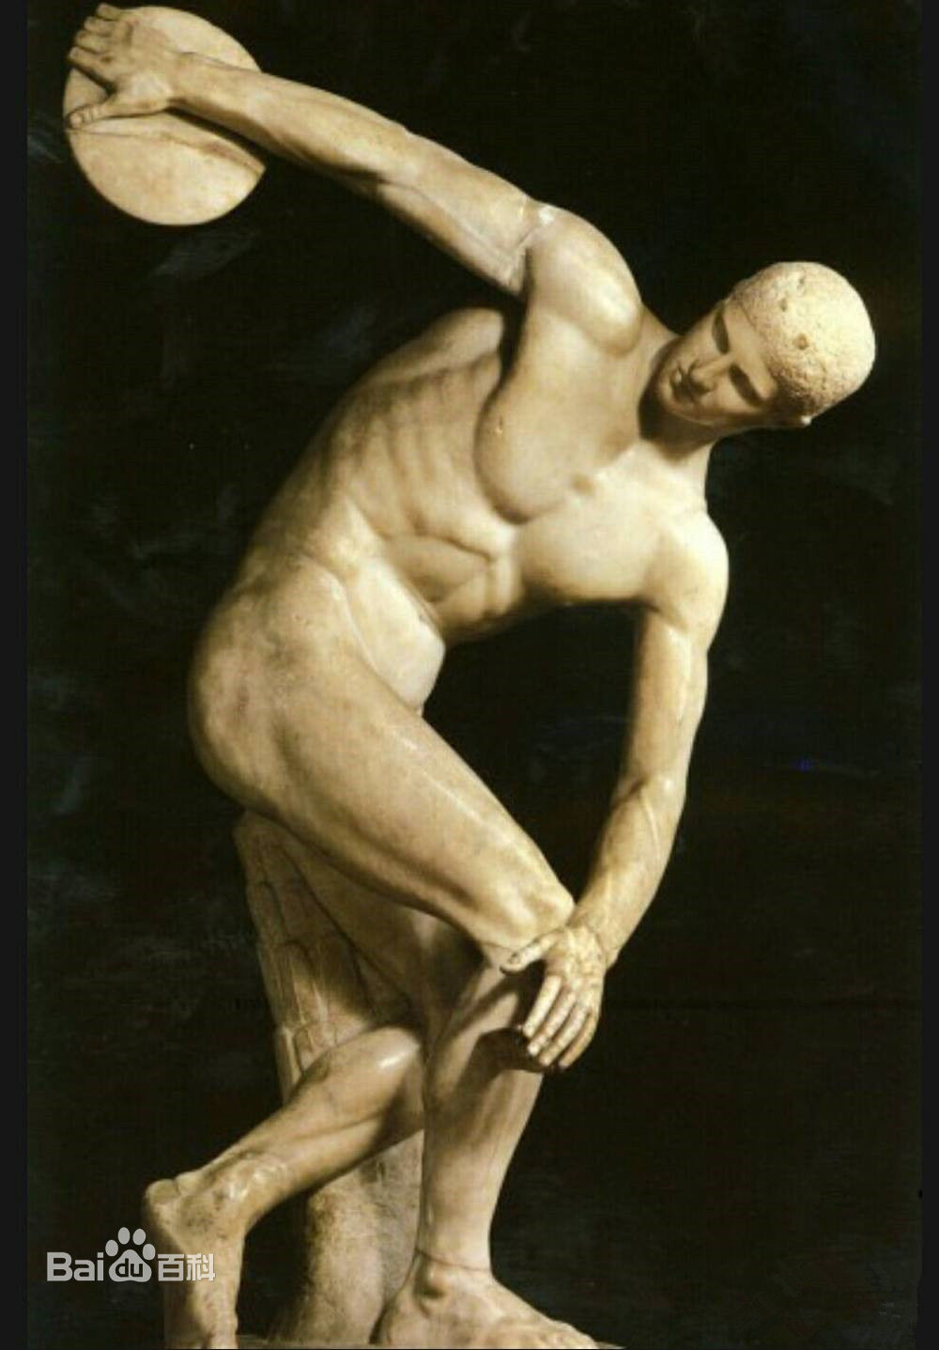
The difference between Chinese and Western art
The Specialty of Sculpture Art in Qin Dynasty
Freehand
Realistic
The First Emperor of Qin
Terra-Cotta Warriors

Slide 4
The difference between Qin and other dynasties
The Specialty of Sculpture Art in Qin Dynasty
The difference between Chinese and Western art
Freehand
Realistic
Discobolus (掷铁饼者)

Slide 5
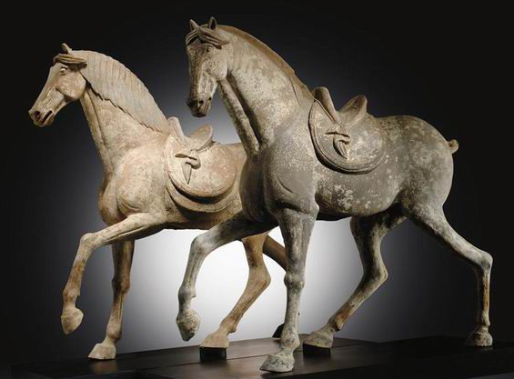
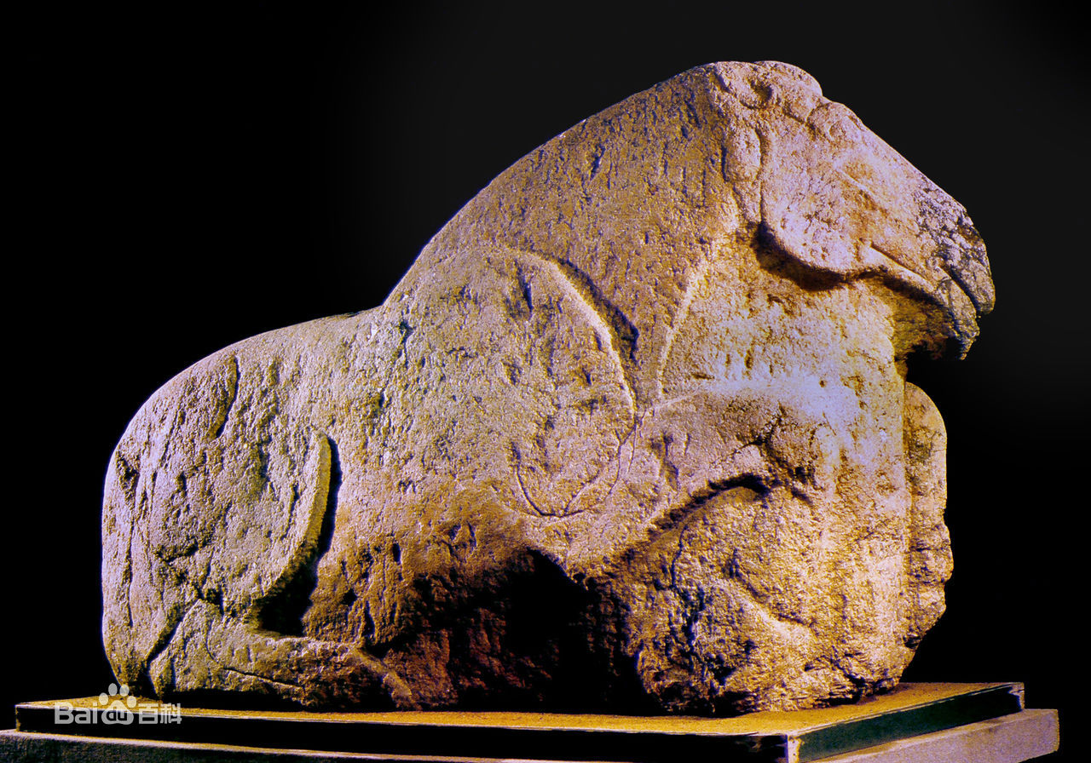
The difference between Chinese and Western art
The difference between Qin and other dynasties
Realistic
Freehand
The First Emperor of Qin
Terra-Cotta Warriors

Slide 6
The
Spec
of Sculpture Art in Qin Dynasty
ialty
The difference between Qin and other dynasties
Realistic
Freehand
《跃马》 陕西兴平霍去病墓
The First Emperor of Qin
Terra-Cotta Warriors

Slide 7
The
Spec
of Sculpture Art in Qin Dynasty
ialty

Slide 8
Variety
Variety
Veracity
Variety
Veracity
Veracity
Spec
ialty
The
of Sculpture Art in Qin Dynasty

Slide 9
Variety
Variety
Veracity
Variety
Veracity
Spec
Veracity
ialty

Slide 10
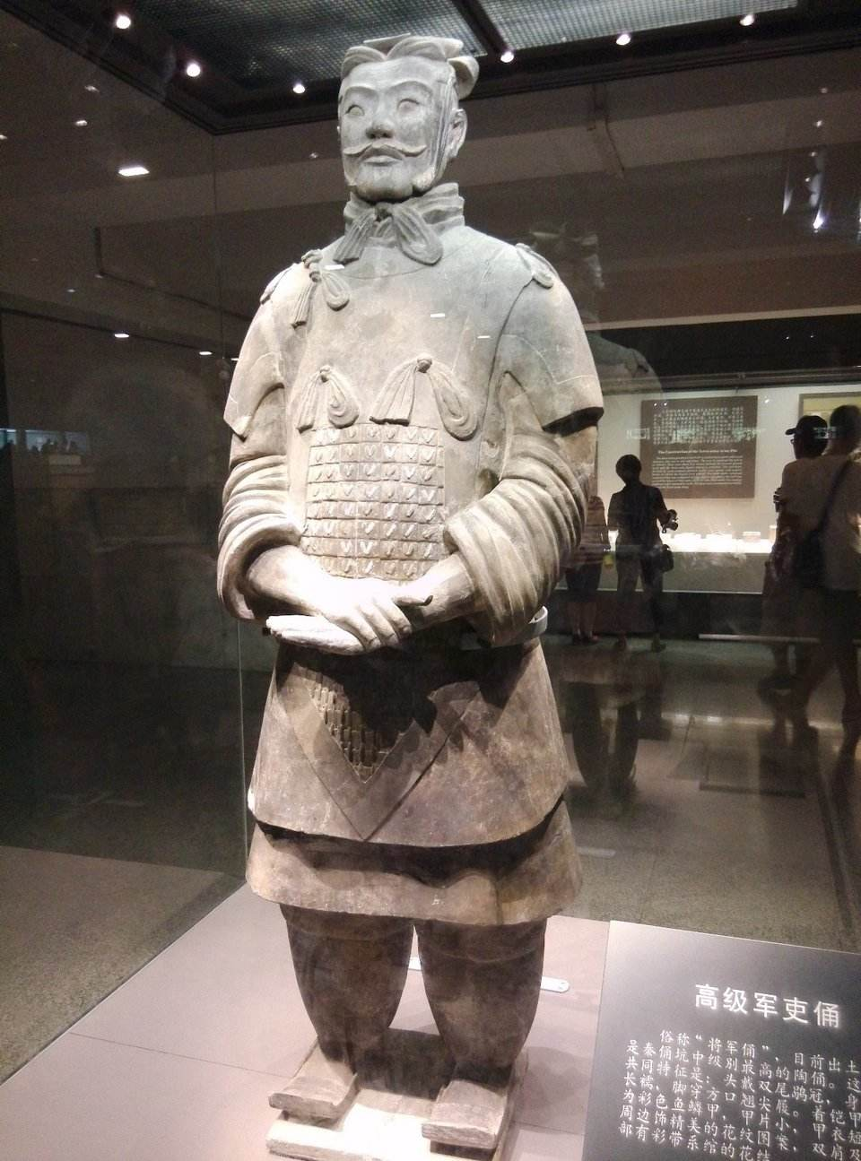
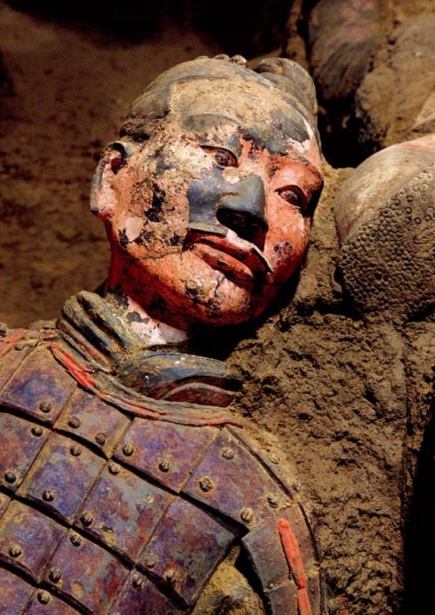
Variety
Veracity
195cm

Slide 11
Veracity
Variety
Kneeling Archer
High-Ranking Officer
Posture

Slide 12
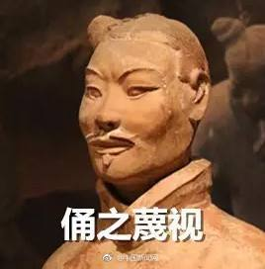
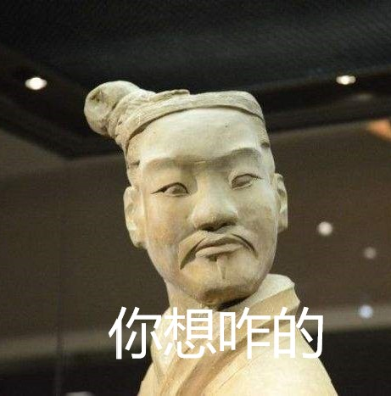
Variety
Facial Expression

Slide 13
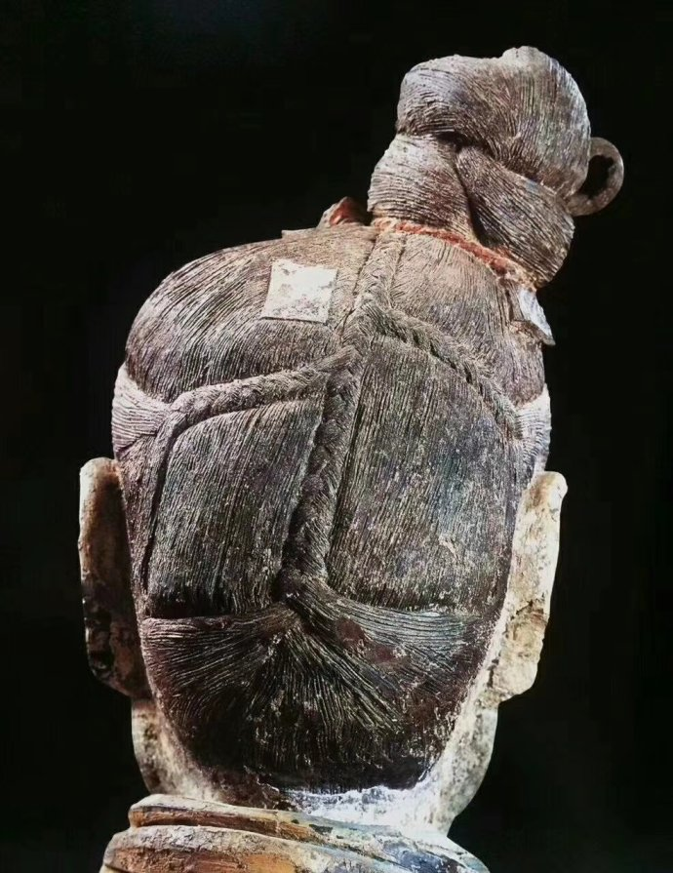
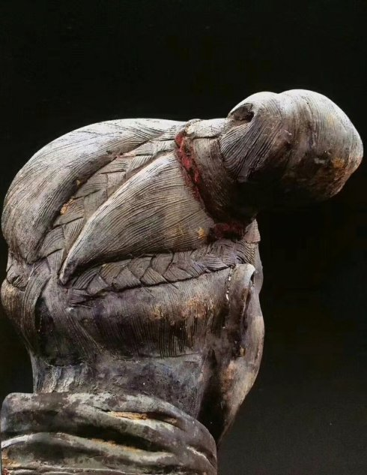
Variety
Hair style

Slide 14
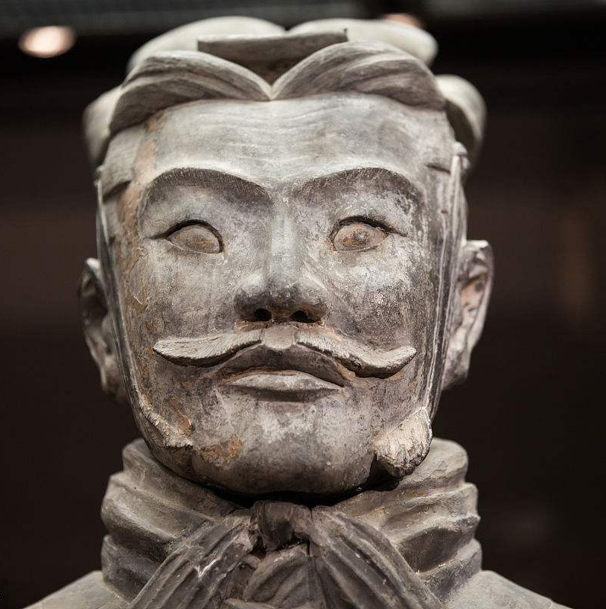
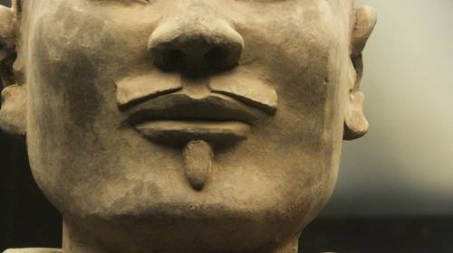
What about
Other dynasties
Variety
Beard

Slide 15
What about
Other dynasties

Slide 16
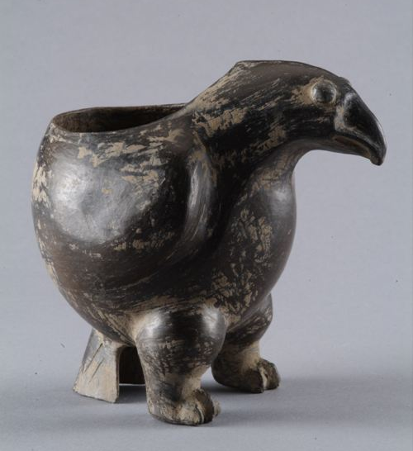
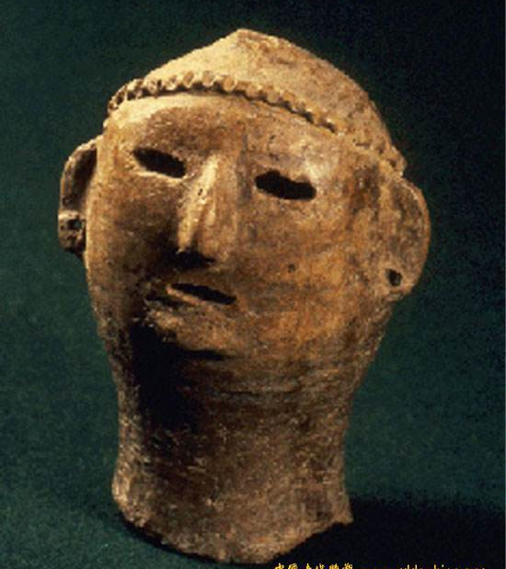
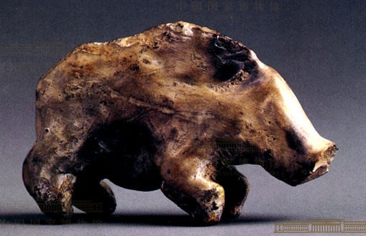
Other dynasties
Primitive Communes
(Pottery carving 陶雕)

Slide 17
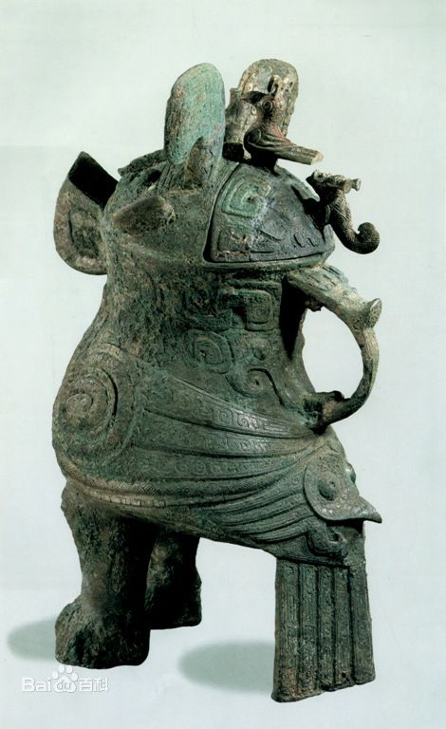
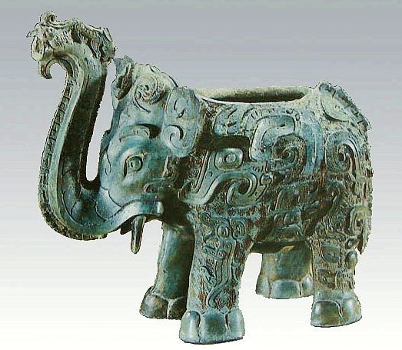
Other dynasties
Pre-Qin
(Bronze Sculpture 铜雕)

Slide 18
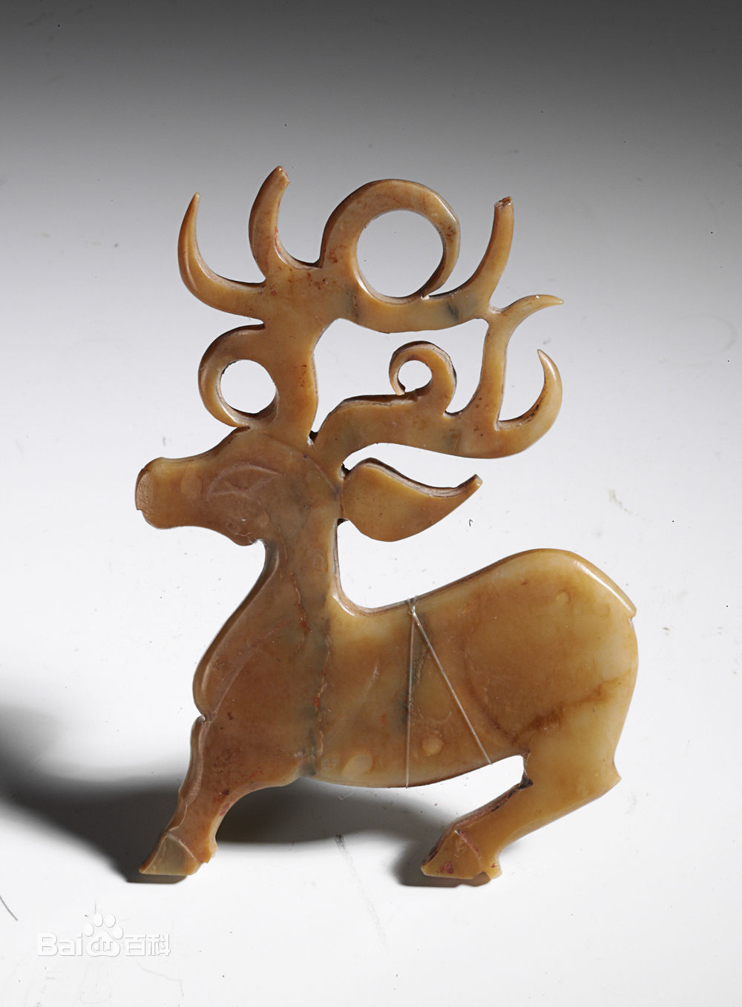
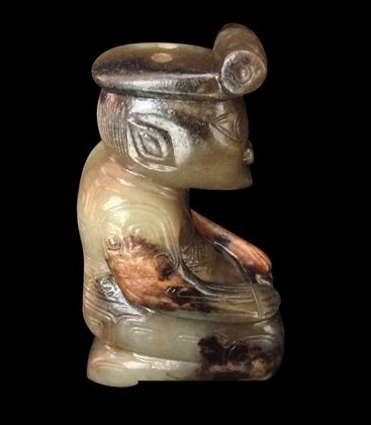
Other dynasties
Pre-Qin
(Jade carving 玉雕)

Slide 19
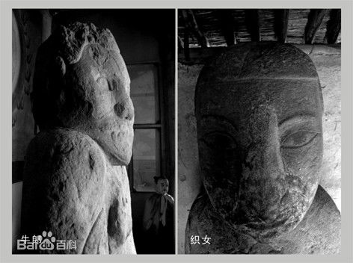
Other dynasties
Han
(Stone carving 石雕)

Slide 20
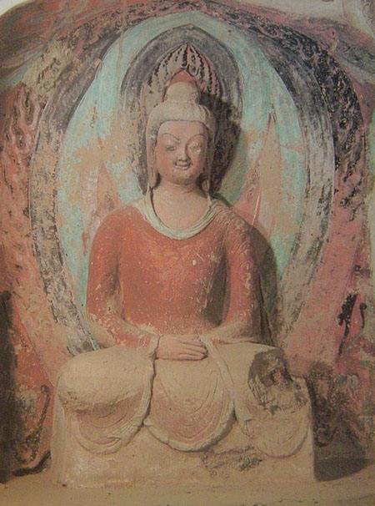
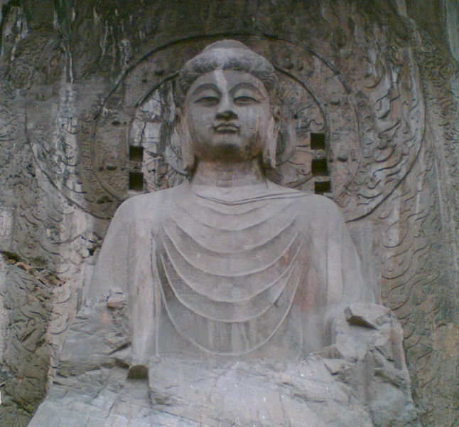
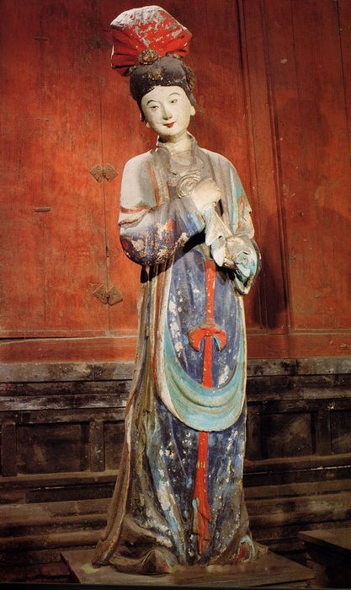
Other dynasties
After Han

Slide 21

Thanks for
Watching
●●●●●●●●●●●●●●●●●●●●●●●●●●●●●●●●●●●●●●●●●●●●●●●●●●●●●●●●●●●●●●●●●●●●●●●●●●●●●●●●

